Slide 1
The Future of Delinquent Accounts Receivable and Student Retention

Slide 2


Introductions
Keith Fitzsimmons
Director of Student Accounting
Karin Sammons
Regional Sales Executive

Slide 3
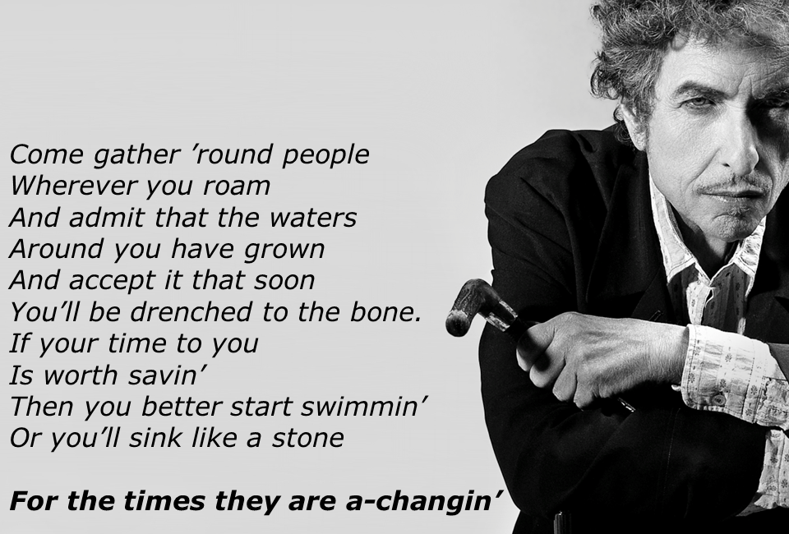

Slide 4
What are receivables?

Slide 5

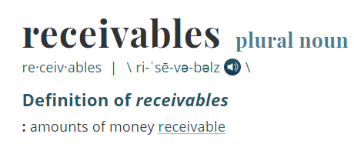

Slide 6
Are receivables good or bad?

Slide 7
Or both?

Slide 8
What’s good?

Slide 9
Home second home vehicle vacation medical services higher education

Slide 10
What’s bad?

Slide 11
No money from sale risk of not being paid
No money from sale risk to other assets no money from sale

Slide 12
Who here has receivables?

Slide 13
What role do receivables play at your institution?

Slide 14
What does student retention have to do with receivables?

Slide 15
How do receivables impact you?

Slide 16
What could possibly go wrong?

Slide 17

“It’s just a bit of ice. Oh, not to worry, quite normal for this time of year.”
Edward Smith
RMS Titanic
1912 Maiden Voyage

Slide 18

So, what can happen?
Paid
Not Paid

Slide 19

What happens when things don’t go as planned? As with this 100+ year old Orange Osage tree.

Slide 20

Or when receivables are not paid?
Hope?
Pray?
Beg?
Threaten?
Take their word for it?
Forget it???

Slide 21

Forget it? Won’t the boss just love that…

Slide 22
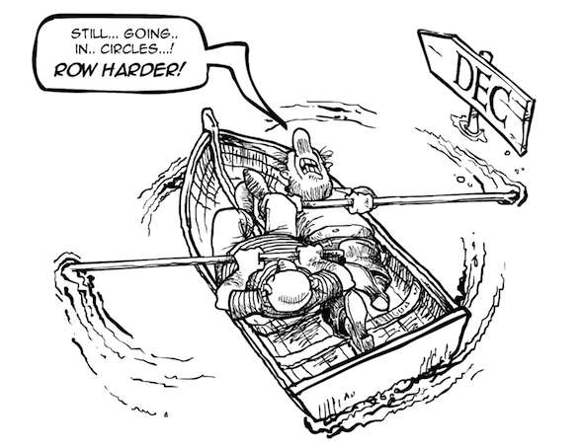

Slide 23
Here’s what KUMC did
The future of delinquent accounts receivable.

Slide 24
Accounts Receivable at KUMC
$55 million annual T&F
Over $1 Billion in 32 years
$800,000 in delinquent accounts receivable over one year old.
Just a drop in the bucket! (.08%)
My boss still wasn’t happy about that $800,000
We found that paying KUMC was not everyone’s first priority.
We were spending too much time chasing these students with old accounts.
Hate sending students to collections.
Too many bad debt write-offs.
$800,000 delinquent accounts receivable over one year

Slide 25
What did we need (and want) to do?
Clear out old past due accounts and accelerate the recovery process.
Keep the delinquency between us and them.
Maintain our relationships with alumni – second chance approach makes the interaction positive.
Opportunity not amnesty

Slide 26
Third-Party Intervention
First Pass
$404,000 Updated/Placed
$236,500 Balance
$167,500 cleared in 4 months!
$243,859 - current over 1 year A/R balance

Slide 27

Other Benefits
Much easier for students with balance due from prior terms to enroll – increases student retention
Flexible payment plans to fit into each student’s budget – buys students time to get back on track
Maintains positive relationships with alumni by keeping them out of the collections process - increases donor potential

Slide 28
So, where does KUMC go from here?
Short Term
Long Term
Current students are easier to contact (timing and consistency)
Use “save late fees” as the incentive
Focus on no enrollment holds
Automatic placement of accounts
Increased contact with debtors
Focus on restoring enrollment and protecting credit report

Slide 29
The future of student retention

Slide 30
Student Engagement Best Practices
Financial Aid & Admissions
Access to Calculators, Websites, Videos, & Customized Info
Financial Education Seminars & Workshops
Peer Learning & Mentoring
One-to-One Counseling
Entrance, Exit, and Credit Counseling

Slide 31
So, who here has the time?

Slide 32


Typical Process
This is Joe.
Joe is enrolled and graduating Spring 2019.
Joe can’t pay, so he is sent to collections in the spring & can’t graduate.
Joe has a $2,000 balance for the fall semester.
Fall 2018
Spring 2019

Slide 33
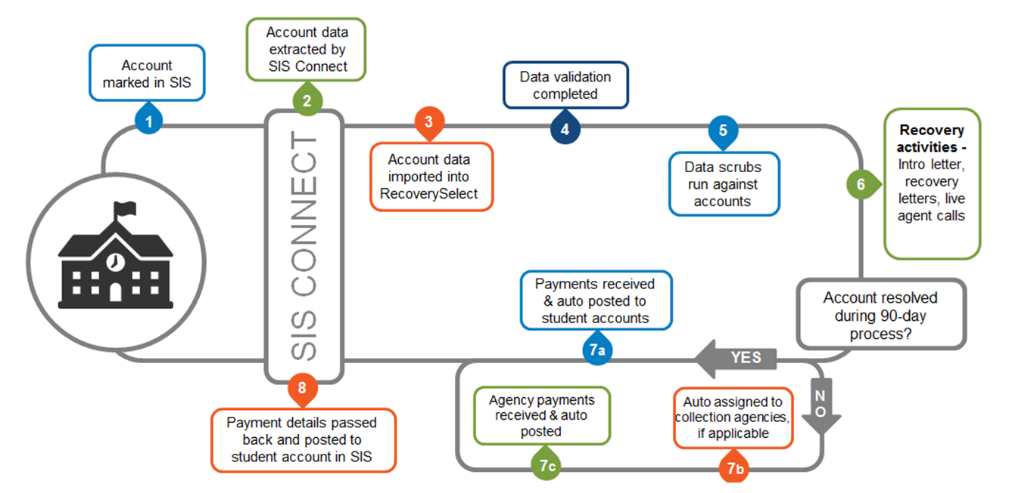
How does RecoverySelect work?

Slide 34
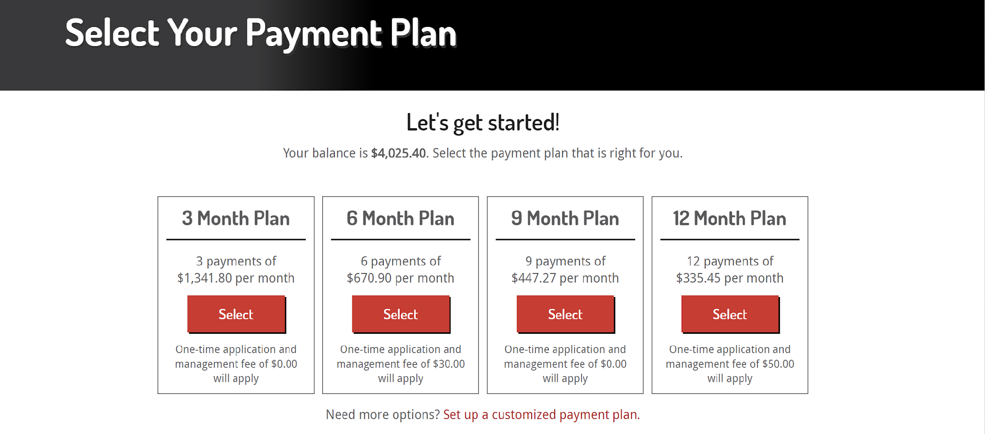
Customizable Payment Plans
$25.00
$40.00
$55.00
$70.00

Slide 35

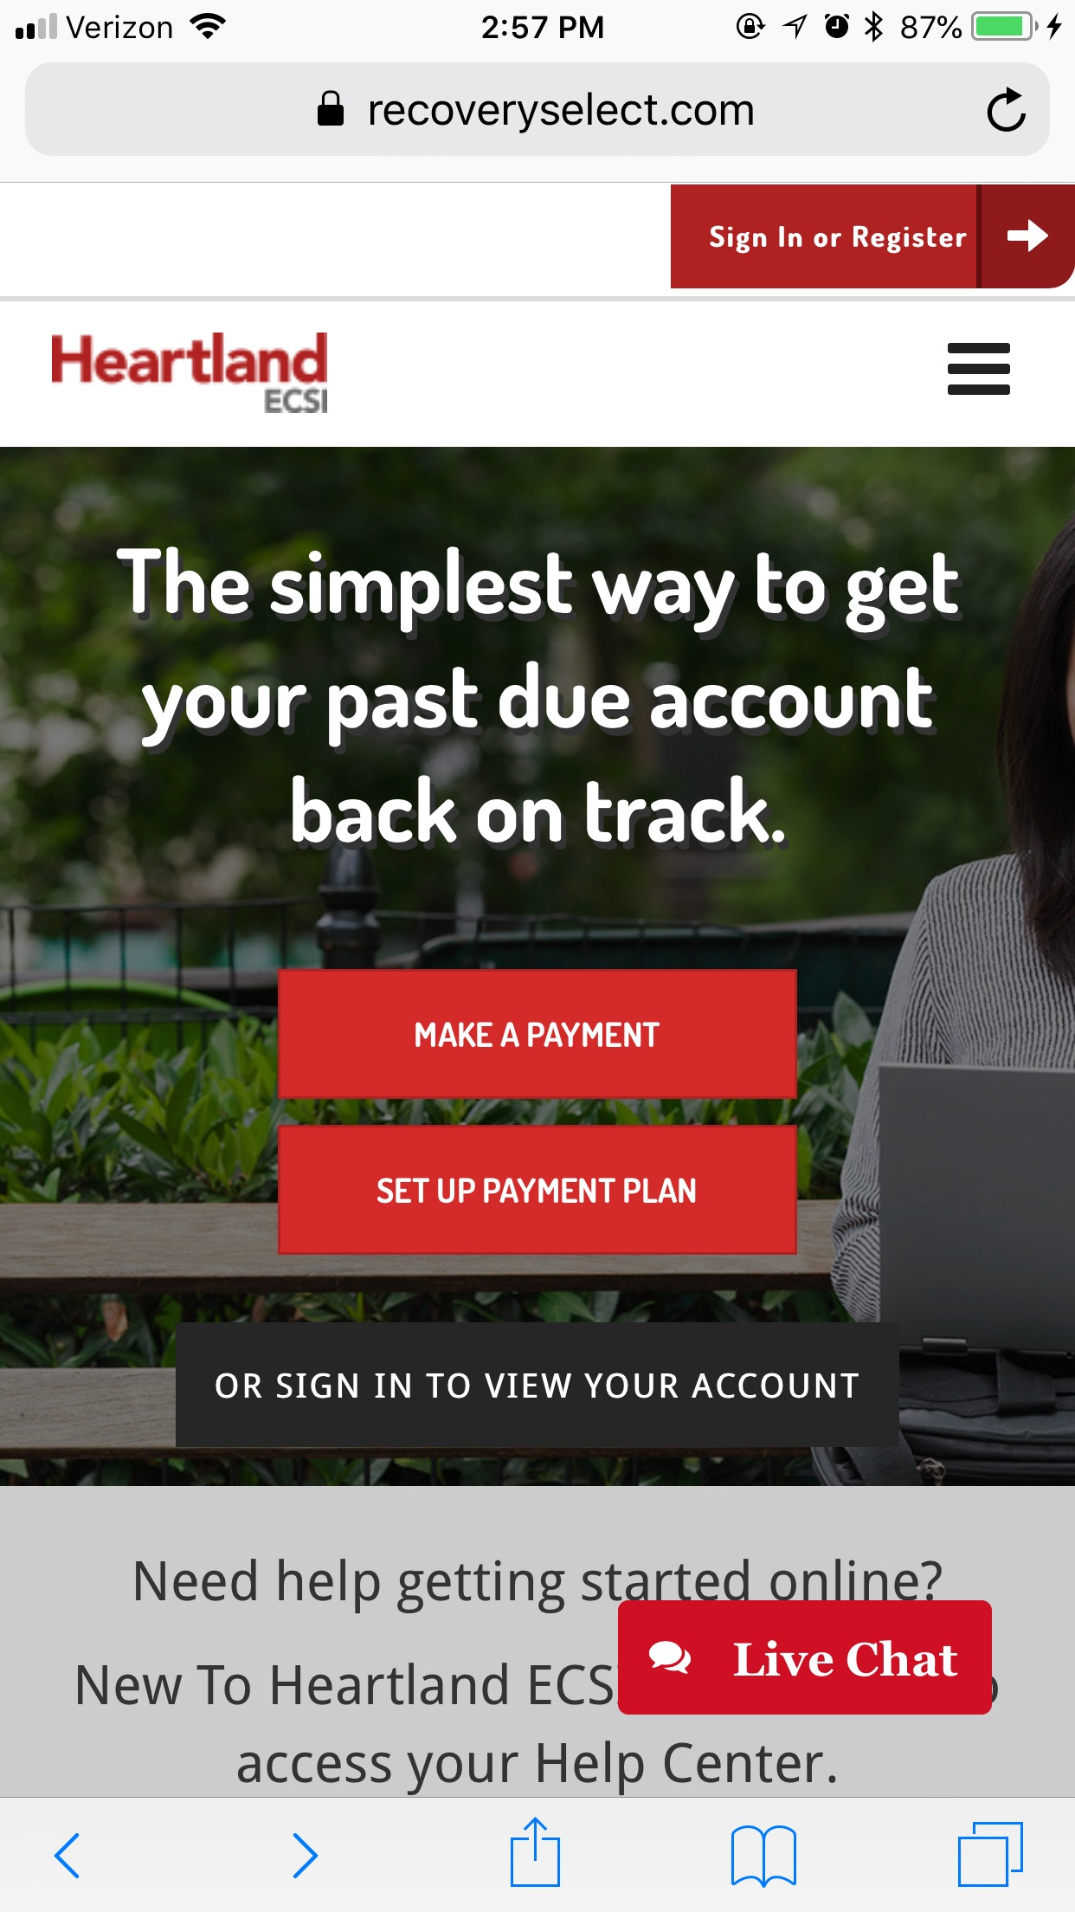
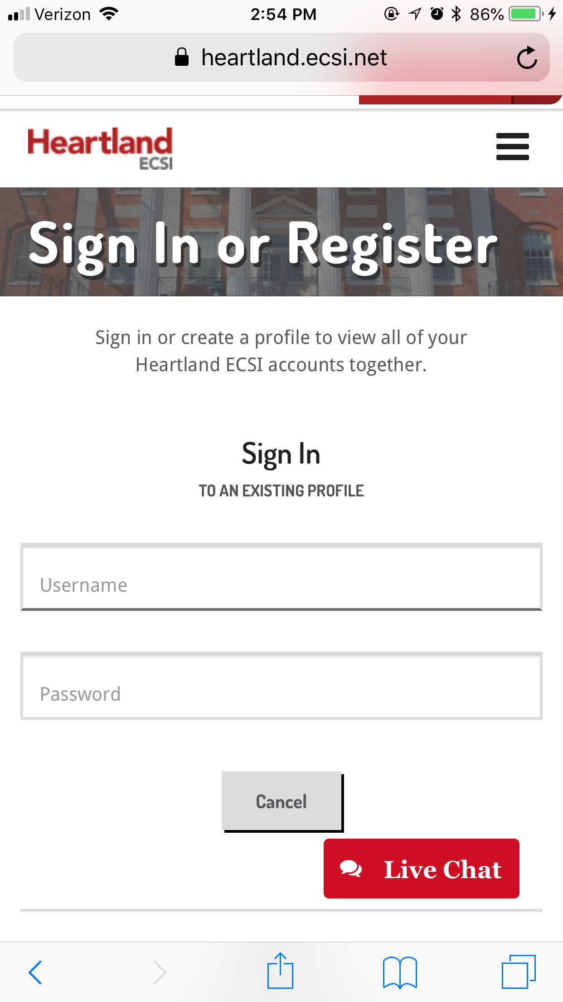
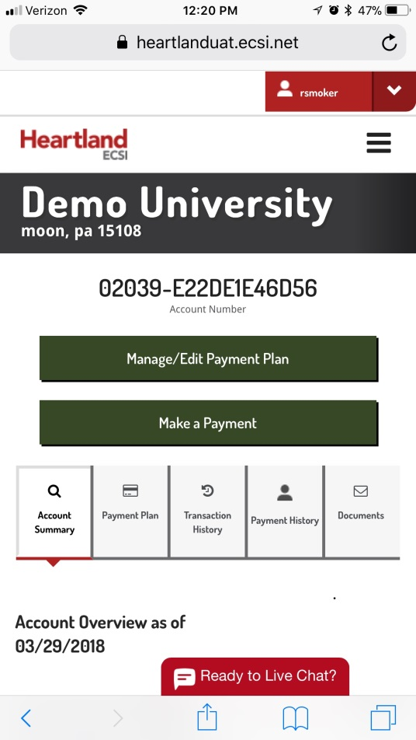
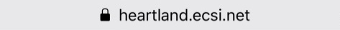
Convenient Access and Payments

Slide 36

So, what does this mean for Joe?
Fall 2018
Fall 2018
Spring 2019
Joe has a $2,000 balance for the fall semester.
Joe is past due, his account is assigned to ECSI & Joe sets up a payment plan.
Additional $2,000 spring balance is rolled into Joe’s ECSI payment plan.
Joe pays his balance in full and receives his diploma & transcripts.
Joe is allowed to graduate with a hold on his transcript & diploma.
Balance Paid in Full
Spring 2019 Graduation

Slide 37
RecoverySelect Re-Enrollment Revenue
500 Students
sent to ECSI
50 Students (or 10%)
re-enroll for one year
50 Students x $20,000 tuition =
$1,000,000

Slide 38

Why Schools Say YES to RecoverySelect
Engagement, retention, & revenue
We do the grunt work, and you do what you were hired to do
Fewer students going to collections

Slide 39
Questions?

Slide 40
Thank you!

